Slide 1
Cloud BSS
James Fanchiang

Slide 2
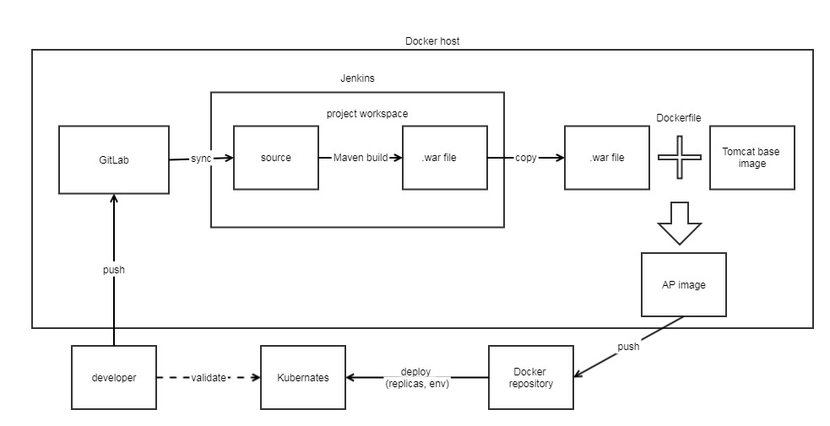
Devops for Cloud BSS

Slide 3
Cloud BSS framework
User
Admin
Batch
Controller
Model
Runner
Templates
Core
Service
Model
DAO
Entity
hibernate
JPA
Oracle

Slide 4
The framework
DB: Hibernate + JPA
Backend: Spring boot 2.0
Frontend: Thymeleaf + jQuery
API: Restful + JSON data (new interface)
Version control: GIT
Dependency: Maven
Deploy: Docker (K8s)

Slide 5
Restful API principle
hpc/api/company/{id}
Post/Get/Push/Delete/Patch resource
hpc/api/company/search
Post
Data: JSON
Data class: model

Slide 6
Than you !

